Slide 1
Chapter 07
Organizational Culture

Slide 2
Objectives
Different Types of Cultures
Organizational Culture Analysis
Culture at the Foundation of KM
Transformation to a Knowledge-Sharing Culture
Strategic Implications of Organizational Culture
Practical Implications of Organizational Culture

Slide 3
Introduction
As the soil, however rich it may be, cannot be productive without cultivation, so the mind without culture can never produce good fruit.
- Seneca (Roman senator, ca. 60 B.C. - 37 A.D.)

Slide 4
Introduction
Myth in KM
  Built it and they will come / use
  Technology will replace face-to-face interactions
  First, change the organization culture to one of learning
Organization’s cultural environment play a crucial role in determining what happen to KM within that organization

Slide 5
Introduction
Culture refers to the underlying values, beliefs, attitude, behavior, & codes of practice that make a community/organization what it is
The customs of society, the self-image of its members, the things that make different from others, are its culture

Slide 6
Culture definition
Organizational culture (Schein, 1999)
  “a pattern of basic assumptions - invented, discovered, or developed by a given group when they cope external adaptation and internal integration”
  Worked well enough to be considered valid the taught to new members as the correct way to perceive, think and feel in relation to problem” -> they war we do things around here

Slide 7
Culture definition
Culture thus defines consistent ways in which people perform tasks, solve problem, resolve conflicts, treat customers and employees, and so on.
An informal values, norm, & beliefs that control how individuals & groups in an organization interact with each other and people outside the organization

Slide 8
Factors affecting culture
What make an organization culture:
  Individual working (attitudes, mentalities, interests, perception and even the thought process of the employees) affect the organization culture
  The nature of the business (fierce or mild competition)
  Its goals and objectives (the strategies and procedures)
  The clients and the external parties
  The management and its styles of handing the employees also affect the culture pf the workplace

Slide 9
Key elements of culture
Key element of organizational culture (Morgan, 1977)
  Stated and unstated values
  Overt and implicit expectations for member behavior
  Customs and rituals
  Stories and myths about the history of the group

Slide 10
Key elements of culture
Key element of organizational culture (Morgan, 1977) (con’t)
  Shop talk - typical language used in and about the group
  Climate - the feelings evoked by the way members interact with one another, with outsiders, and with their environment, including the physical space they occupy
  Metaphors and symbols - which may be unconscious or embodied in other cultural elements

Slide 11
Organization culture
Culture is created and ingrained unconsciously
Need special effort to recognize that the attitudes, beliefs, and visions are standardized assumptions that they may pass on to future generations
Sensing the culture is difficult because the core of the culture values, which defined as “broad, nonspecific feelings of good and evil, beautiful and ugly, normal and abnormal, rational and irrational are often unconscious and rarely discussable” (Hofstede et al., 1990)
Organizational culture, thought as the manner in which an organization solves problems to achieve its specific goals and to maintain itself over time.

Slide 12
Different Types of Cultures
While an organization characterize by particular culture, there always be some different type of micro-culture inside that organization
Goffee and Johns identify 4 type of culture, which they create using 2 dimensions
  Sociability -> friendliness without expect something in return. Focus on team and process
  Solidarity -> task oriented. People work well towards common goal

Slide 13
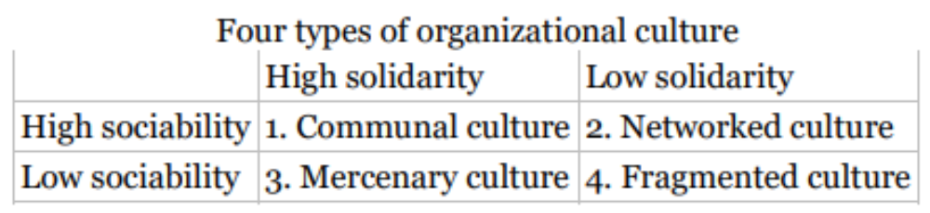
Different Types of Cultures

Slide 14
Different Types of Cultures
 | High solidarity | Low solidarity
High sociability | 1. Communal culture | 2. Networked culture
Low sociability | 3. Mercenary culture | 4. Fragmented culture

Slide 15
Different Types of Cultures
Type of Culture
  1. A communal culture can give its members a sense of belonging, though it also is task-driven. Leaders of this culture are usually very inspirational and charismatic. The major negative is that leaders often exert too much influence and other members are rarely heard from.
  2. In a networked culture, members are treated as friends and family. People have close contact with each other and care for each other. People are willing to help each other and share information. The disadvantage of this culture is that people are so kind to each other that they are reluctant to point out and criticize poor performance.

Slide 16
Different Types of Cultures
Type of Culture (con’t)
  3. A mercenary culture focuses on strict goals. Members are expected to meet the goals and get the job done quickly. Since everyone focuses on goals and objectivity, there is little room for political cliques. The negative is that those with poor performance may be treated inhumanely.
  4. In an organization with fragmented culture, the sense of belonging to and identifying with the organization is usually very weak. The individualists constitute the organizations, and their commitment is given first to individual members and task work. The downside is that there is a lack of cooperation.

Slide 17
Example of Organization Culture
TELKOM 5C:
  Commitment to Long Term
  Customer First
  Caring Meritocracy
  Co-creaction of Win-win Partnership
  Collaborative Innovation

Slide 18
Example of Organization Culture
COCA COLA:
  Our inclusive culture is defined by our seven core values: Leadership, Passion, Integrity, Collaboration, Diversity, Quality, and Accountability.
  Our central promise at The Coca-Cola Company is to refresh the world in mind, body, and spirit, and inspire moments of optimism; to create value and make a difference.

Slide 19
Culture and Knowledge
Prerequisites of a culture that fosters KM is the notion of trust.
When members feel that they are respected, treated in a professional manner, can trust the other members of their group, then knowledge sharing is greatly enhanced.
Trust removes any potential barriers, people won’t feel hesitate to share knowledge, for it’s all for greater cause.

Slide 20
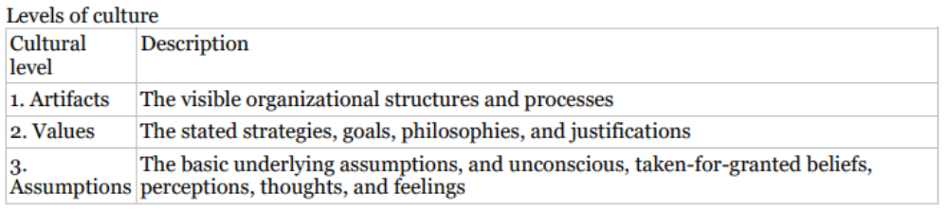
Organizational Culture Analysis

Slide 21

Organizational Culture Analysis
Cultural level | Description
1. Artifacts | The visible organizational structures and processes
2. Values | The stated strategies, goals, philosophies, and justifications
3.Assumptions | The basic underlying assumptions, and unconscious, taken-for-granted beliefs, perceptions, thoughts, and feelings

Slide 22
Organizational Culture Analysis
Artifacts
  The first layer, are easy to detect (e.g., a dress code), but they may be difficult to understand.
  Represent ―the tip of the iceberg,‖ and it remains a challenge to discern or decipher what lies underneath them (i.e., what is the reason for this type of dress code or other visible structures and processes?).
  Basic assumptions in organizational culture are usually represented by general and abstract statements that express certain ideas and truths about human beings

Slide 23
Organizational Culture Analysis
The values
  From an organizational perspective, values express essential meanings of basic assumptions.
  Values define a set of its members’ organizational expectations. Values are expressed and imposed by the managerial and become a reference for activity assessment. They are included in attitudes and behaviors, in the organizational habitat. The two levels, assumptions and values, represent the content of what we call an organization expressive area or expressive culture.

Slide 24
Organizational Culture Analysis
Norms derives from cultural value & basic assumptions
Norms are expressed in a set of rules and expectations and serve to orient people’s behavior within the organization
2 type of norms
  Informal, produce by member or group
  Formal, produce by authority

Slide 25
Organizational Culture Analysis
Small game based from the Dalkir’s book (184)
  Form small group of 4 student
  The rain, the tent, the big tree, the lunch
  Discuss the result in class
Culture change is difficult, time-consuming, and anxiety provoking
Schein’s 3 step approach for changing culture ;
  Unfreezing
  Cognitive restructuring
  Refreezing

Slide 26
Culture at the Foundation of KM
KM implementation require cultural change
KM will always trigger a change
People tend to opposed change if they feel imposition rather than improvement
Knowledge-sharing culture, should built upon trust (it is necessary to inform, involve, & inspire organizational member during the organizational changes)
Corporate culture is a key component of ensuring that knowledge & information flow within organization.

Slide 27
Culture at the Foundation of KM
Commitment of a corporate culture always more important than the communication technologies
The smoothness of information flow (vertically & horizontally) will ensure the success of the KM
KM need a lingua franca, something in common (language, standards, norms, procedures)
Knowledge creation is about participation & collaboration, not individual effort

Slide 28
Culture at the Foundation of KM
A knowledge-sharing culture is:
  Where knowledge sharing is the norm, not the exception,
  Where people are encouraged to work together, to collaborate and share,
  Where they are rewarded for doing so.

Slide 29
Culture at the Foundation of KM
Challenge to share explicit knowledge:
  Hard to find,
  Different systems and no standards,
  The information was not where it should be,
  The tools were difficult to use,
  The database was not easily accessible.

Slide 30
Culture at the Foundation of KM
Challenge to share tacit knowledge:
  Attitudes that knowledge was power,
  Not knowing who the expert was,
  Not knowing if the knowledge exists,
  Loss of knowledge when people left the company

Slide 31
Culture at the Foundation of KM
Ideal knowledge sharing culture is:
  Where communication & coordination between groups were emphasized,
  Where experts would not jealously guard their knowledge, and
  Where knowledge sharing would be actively and visibly encouraged at all levels of the hierarchy through recognizing & rewarding knowledge sharing and through embedding such statements in corporate and individual performance objectives

Slide 32
Culture at the Foundation of KM
Characteristic of knowledge sharing environment (Gruber and Duxbury, 2001);
  Reward structure - recognition for knowledge sharing with peers.
  Openness/transparency - no hidden agendas.
  Sharing supported - communication and coordination between groups.
  Trust - shared objectives.
  Top management support - upward and downward communication

Slide 33
Culture at the Foundation of KM
3 basic ways to create cross-individual behavior consistency:
  Social norms
  Social value
  Shared mental model

Slide 34
Culture at the Foundation of KM
Social norms
  Social norm is a behavioral expectation that people will act in a certain way in certain situations.
  Norms (as opposed to rules) are enforced by other members of a reference group through use of social sanctions
  Three norms characteristics; pheriperal, relevant, pivotal

Slide 35
Culture at the Foundation of KM
Social value
  Public values arise when we believe that everyone around us holds a certain value (social value)
  We often act in ways consistent with that value, even though we don’t personally hold that value. This is done to gain acceptance and support from the group

Slide 36
Culture at the Foundation of KM
Shared mental model
  Basic underlying assumptions.
  Mental models impact the behavior of individuals to a very large extent. Decisions are often based on one or more of our mental models.
  For example, if a manager believes that increasing satisfaction will enhance employees’ performance, he or she is likely to do things that eliminate dissatisfaction among employees and work hard to increase their levels of satisfaction.

Slide 37
Culture at the Foundation of KM
Learning development
  Direct schema development. When we first perform our task, we tend to think about every step the many alternative ways we can perform it. As we learn the best way to perform the task, we “lock in” the script, and do not think about each step again
  Indirect schema development. We simply copy (or are told) how to perform a certain task from members of the reference group

Slide 38
Culture at the Foundation of KM
Consensual schema
  When direct and indirect schema become routine and account for large number of cross-individual behavior consistency

Slide 39
Culture at the Foundation of KM
Organization culture
  Establishes a set of roles (social identities).
  Establishes a set of role expectations (traits, competencies, and values) associated with each identity.
  Establishes the status or value/worth to the reference group of each social identity.
  Provides values, cognitive schema, & mental models to influence how individuals behave in various groups (microculture) and organizational culture

Slide 40
Transformation to a Knowledge-Sharing Culture
Changing the organization’s structure (rules, regulations, rewards systems), mean changing the underlying mechanisms that drive these behavioral patterns: namely, norms, social values, or mental models
Changing structure by changing rule and its enforcement mechanism is rather simple when compared to changing a social value.
Culture is resistant to change because the cultural control mechanisms become internalized in the minds of organizational members

Slide 41
Transformation to a Knowledge-Sharing Culture
Organizational change (difficult & lengthy to undertake) is a critical requirement for most KM implementations.
The key often lies in symbolic action, that is, dealing with important symbols of values, norms, and assumptions.
Kilmann, Saxton, and Serpa (1986) provide some good general guidelines

Slide 42
Transformation to a Knowledge-Sharing Culture
The guide lines are:
  People look to leaders for cues about what is important
  Culture is often transmitted through stories and myths that treasure certain virtues held to be important for organization.
  In reacting to crises, leaders can send the values and assumptions of the organizations

Slide 43
Transformation to a Knowledge-Sharing Culture
The guide lines are (con’t):
  A reward system send powerful messages about what is important
  Important & public decisions communicate the importance of certain values (training cut, allocation of resources)
  Leaders communicate the importance of values by what they praise and what they criticize.
Find at least two company which are concern to enforce the knowledge sharing culture. Read page 192 - 193 as an example.

Slide 44
Transformation to a Knowledge-Sharing Culture
Steps in creating KSC:
  Having knowledge journalists begin interviewing key people to document projects, best practices, lessons learned, and good stories.
  Instituting KM get-togethers, (breakfasts, lunch & learn sessions, or any type of informal gathering
  Producing newsletters to publicize KM initiatives and celebrate good role models.
  Launching KM pilot projects, (expertise location systems and intranets with space devoted to different communities of practice)

Slide 45
Transformation to a Knowledge-Sharing Culture
Steps in creating KSC:
  Changing performance evaluation criteria to reflect and assess knowledge sharing competencies and accomplishments.
  Censuring knowledge hoarders and rewarding effective knowledge sharers.
  Redesigning workplaces to allow for gathering places

Slide 46
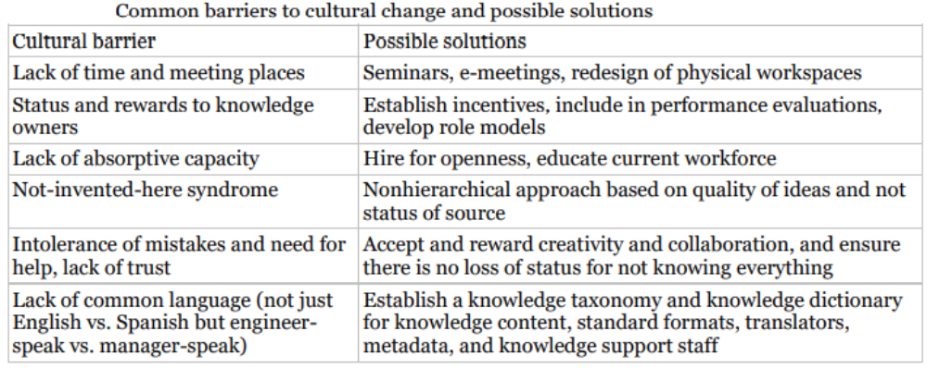
Practical Implications of Organizational Culture

Slide 47
Practical Implications of Organizational Culture
Cultural barrier | Possible solutions
Lack of time and meeting places | Seminars, e-meetings, redesign of physical workspaces
Status and rewards to knowledge owners | Establish incentives, include in performance evaluations, develop role models
Lack of absorptive capacity | Hire for openness, educate current workforce
Not-invented-here syndrome | Nonhierarchical approach based on quality of ideas and not status of source
Intolerance of mistakes and need for help, lack of trust | Accept and reward creativity and collaboration, and ensure there is no loss of status for not knowing everything
Lack of common language (not just English vs. Spanish but engineer speak vs. manager-speak) | Establish a knowledge taxonomy and knowledge dictionary for knowledge content, standard formats, translators, metadata, and knowledge support staff

Slide 48
Summary
Defined organizational culture
Describe different type of organizational culture a
Understand the relation between organizational culture and the business context
Describe how organizational culture intersects with knowledge management
Discuss the key organizational culture enablers and the obstacles to effective knowledge sharing and KM
List the major phases in initiating organizational change

Slide 49

Discussion / Homework / Team Activities
What are some of the key enablers and major obstacles to effective knowledge sharing that can be attributed to the overall organizational culture?
Describe how you would initiate an organizational change initiative. Provide an estimate of how long you believe each stage would last.
What are some of the ways of assessing whether or not the culture is changing, or maturing, toward an intended end state?
What are some of the ways you would go about learning what an organization’s values are? How would you collect and analyze stories, myths, and the typical language used by a particular professional group?
How would you forge a bridge between the largely tacit cultural knowledge of an organization and the largely explicit organizational memory system that should serve to preserve this knowledge?

